Slide 1
Domestic Energy Consumption Trends
Objectives
How has the electricity consumption varied in the last 10 years?
How has the domestic customer base changed in the past 10 years?
What trend is forecasted based on the current data available?
What constraints affect the accuracy of these predictions?

Slide 2

Key Findings From the UK Electricity Consumption Data
The data from the Gov.uk site¹ clearly shows that customer base of electricity consumption is has increased steadily and shows constant YoY growth.
Despite the increasing customer base, the total electricity consumption declined from year 2015 till 2019.
It spiked in 2020 and stabilised in 2021 and 2022 but is once again showing growth from 2023 onwards.
1.The data analysed has been taken from
https://assets.publishing.service.gov.uk/media/69426ec31ec67214e98f3058/Domestic_electricity_consumption_distribution_2015-2024.xlsx

Slide 3
Explanation of Data Used
The data taken originally had three columns – the upper consumption band, lower consumption band and the number of meters that displayed the electric energy consumed within that band. The energy consumption unit is kilowatt-hour (kWh). The third column represents the number of meters, and this data relates to all the domestic meters in UK for the past ten years.
The following charts were created using this data after creating more columns and measures.

Slide 4
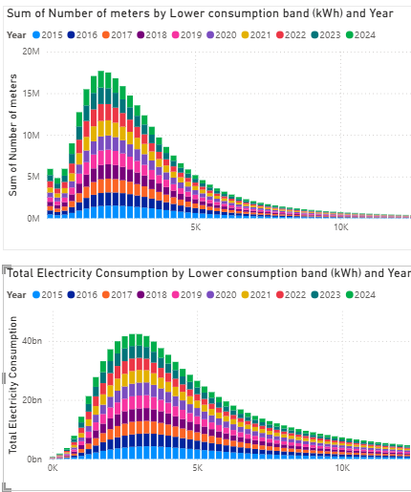
On the left are two charts that were created in PowerBI and are purposely put together to show how the total number of meters installed have changed in the past 10 years.
The x-axis of the top chart shows the electricity consumption band and the y axis displays the number of meters that displayed that energy usage. The number of meters have increased each year with quite a large change in the lowest energy band.
The x-axis of the bottom chart again shows the energy band but the y axis shows the total electricity consumption of households in that band.
This shows that a higher volume of meters are installed but they are not consuming as much energy - meaning that the customer base is increasing steadily.

Slide 5
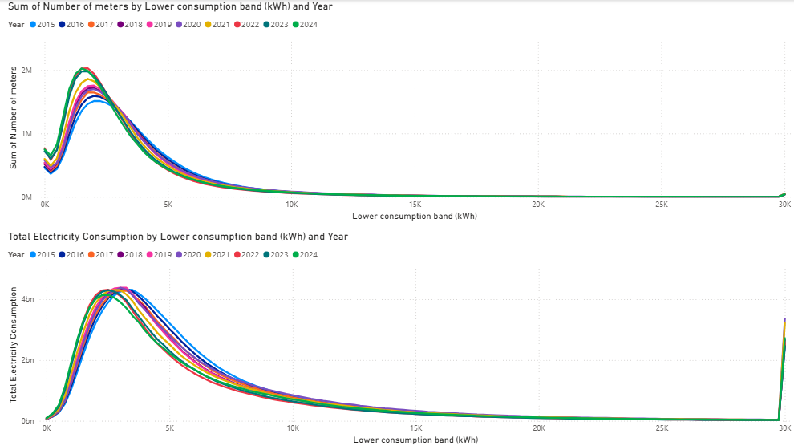
The above two visuals again reinforce the fact in the previous slide. In the top visual there's a rise of meter installation in the lowest energy band and very little increase in the highest energy band. However, in the bottom visual we can clearly see that the rise in meter does not correspond to the rise in energy consumption. The fewest meters in the 30kWk band gives rise to an energy spike in the bottom graph.

Slide 6
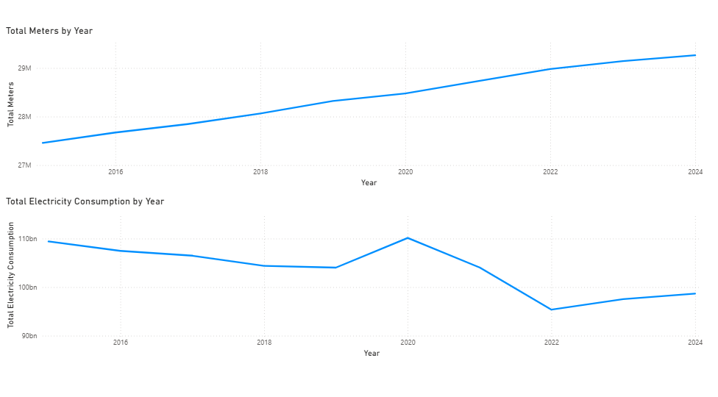
The top graph shows the number of meters that were read each year, showing a solid and consistent increase in customer base . The lower graph shows the total energy consumed by the domestic sector in UK in the past 10 years.
The energy consumption is steadily decreasing from 2015 till 2019. There's a sharp rise from 104 bn kWh to 110bn kWh. There's then a decline in energy usage and a slight increase after 2022. These changes are due to external factors like the work from home policy in covid in 2020 increased energy consumption and then the war in Ukraine gave rise to higher tariffs and in return people consumed less electricity.

Slide 7
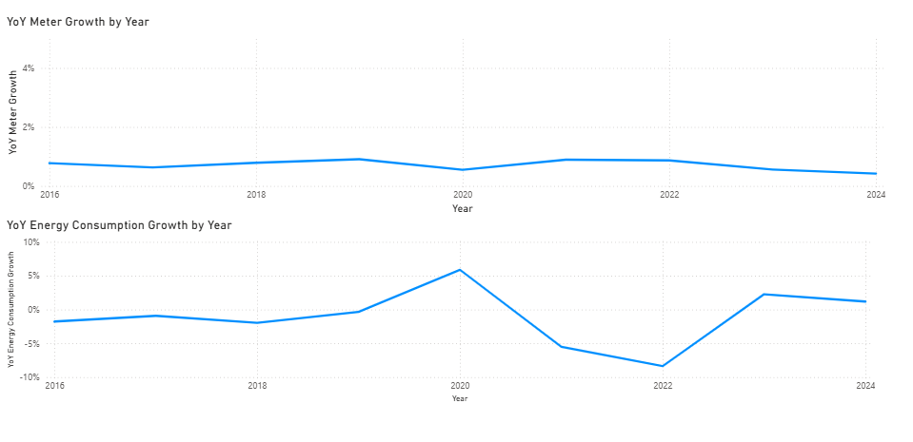
The top two graphs show the YoY growth in number of meters and total energy consumption for the last 9 years. The top graph shows a steady rise in meters showing a steady growth of electricity consumers. This however does not mean that there's a steady rise in electricity consumption. The bottom graph shows positive and negative growth. The electricity consumption is volatile which means that the trend in the short term is unpredictable due to external factors like tariffs, weather etc.

Slide 8
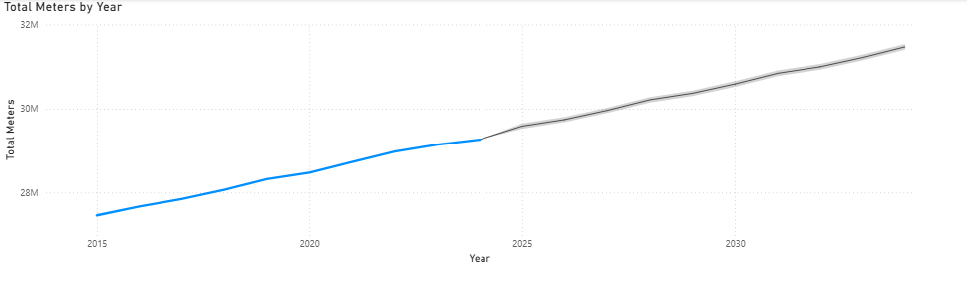
Future Trends in Domestic Electricity Consumption
Having an understanding of the past ten years, it can be predicted that there would be growth in the customer base for electricity consumption. With increasing population and new homes and flats being built, this growth can be extrapolated.

Slide 9
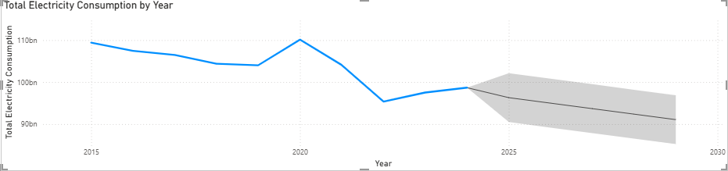
Future Trends...
However, this increase in customer base would not automatically mean increased energy consumption. With rising cost of living and better built new homes with efficient conservation of energy, it can be foreseen that there would be a decline in domestic energy consumption.

Slide 10
Limitations of This Analysis
This analysis is purely based on the open dataset provided.
No other data has been used that would reinforce future trend.
No future policies, change in tariffs or consideration of future weather changes are taken into account.

